Slide 1

Green Pace
Security Policy Presentation
Developer: Evan Baber

Slide 2

OVERVIEW: DEFENSE IN DEPTH
Security Policy Introduction

Slide 3
THREATS MATRIX
Likely
Unlikely
Data Type Data Value String Correctness SQL Injection Threats in this category will be present in any program and are both highly vulnerable and easily fixed | Memory Protection Input / Output Streams Threats in this category constitute vulnerable areas of most programs, but which aren’t first priority targets to attackers
Assertions Exceptions Threats in this category are more akin to bugs that might cause a developer to make mistakes rather than possible attack vectors | Smart Pointers Random Number Generation Threats in this category are vulnerabilities, but aren’t high priority targets or present in most programs
High Priority
Low
Priority

Slide 4
10 PRINCIPLES
Validate Input Data --- Data Type/Value, String Correctness
Heed Compiler Warnings --- Exceptions, Assertions
Architect and Design for Security Policies --- Memory Protection, Smart Pointers
Keep It Simple --- All
Default Deny --- I/O Streams, SQL Injection, Data Value
Adhere to the Principle of Least Privilege --- I/O Streams
Sanitize Data Sent to Other Systems --- I/O Streams
Practice Defense in Depth --- All
Use Effective Quality Assurance Techniques --- Exceptions, Assertions
Adopt a Secure Coding Standard --- All

Slide 5
CODING STANDARDS
Data Type STD-001-DT 1
Data Value STD-002-DV 1
String Correctness STD-003-SC 1
SQL Injection STD-004-SQL 1
Memory Protection STD-005-MP 2
Assertions STD-006-AST 3
Exceptions STD-007-EXC 3
Input & Output Streams STD-008-IOS 2
Use of Smart Pointers STD-009-SPT 2
Random Num. Generation STD-010-RNG 3

Slide 6
ENCRYPTION POLICIES
At Rest:
- Applies to the encryption of data during storage. Data isn’t only at risk when actively moving from one system or another or when being used. Attackers can gain access to stores of data, leading to the opportunity for mass leaks. Keeping data encrypted on disk ensures that even if databases are accessed, attackers won’t have access to easy-to-distribute plaintext data.
- Applies to the encryption of data when moving between systems on a network. Data is particularly vulnerable when travelling from one system to another, and encrypting it before it is sent renders it either useless or much more cumbersome for attackers to use in the event it is intercepted.
- Applies to the encryption of data as it is being accessed as part of a program’s normal operation, but not during transmission as is handled in “encryption in flight”. Data is accessed from databases and input-output streams are opened from files regularly during a program’s use. Just as in network communication, the transmission of data from one part of an application to another represents a weak point at which data is more easily intercepted. Encrypting data as it undergoes these short hops mitigates this risk.
In Flight:
In Use:

Slide 7
TRIPLE-A POLICIES
Authentication
- Applies to how users gain access to systems and what kind of credentials are required to give them that access. Access a program dealing in sensitive data should automatically be gated by a login system. This system should be well maintained, require the updating of credentials, and quickly updated during on-boarding and off-boarding.
- Regards how much access users have to which information once they are authenticated. For this, we should adhere to the principle of “least privilege”, where users are given the lowest level of access necessary to carry out their roles.
- Applies to how developers and administrators keep track of the resources used by a user during their session, or monitor a user’s input to watch for possible red-flags indicating an attempted attack. Accounting should also be instrumental in determining the correct level of privilege discussed in the authorization section.
Authorization
Accounting

Slide 8
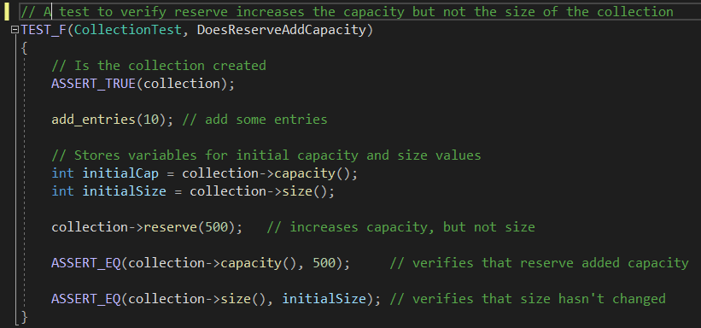
Unit Testing – capacity testing
Does Reserve Add Capacity?
Using the Google Test unit testing framework, we can test different parameters of an array as demonstrated here.
Using Assertions, we populate an array, test its capacity and size parameters, change its reserve parameter and then use another assertion to confirm that it’s initial capacity hasn’t changed.
Result:

Slide 9
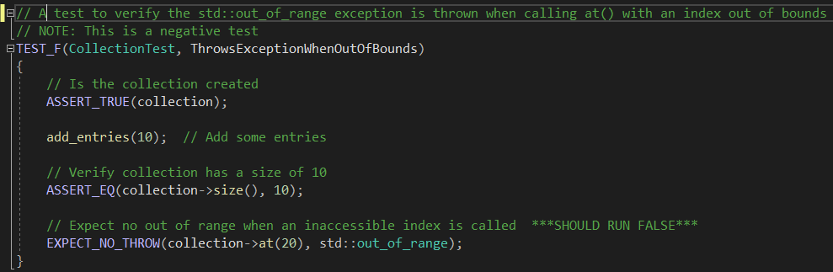
Unit Testing –
Exception Handling
Does the program throw exceptions when a value is out of bounds?
This test returns an intentionally false result to let us know that a program responds correctly when we attempt to access an array index that doesn’t exist.
Because we used an “expect” statement rather than an “assert” statement, our tests continue running.
Result:

Slide 10
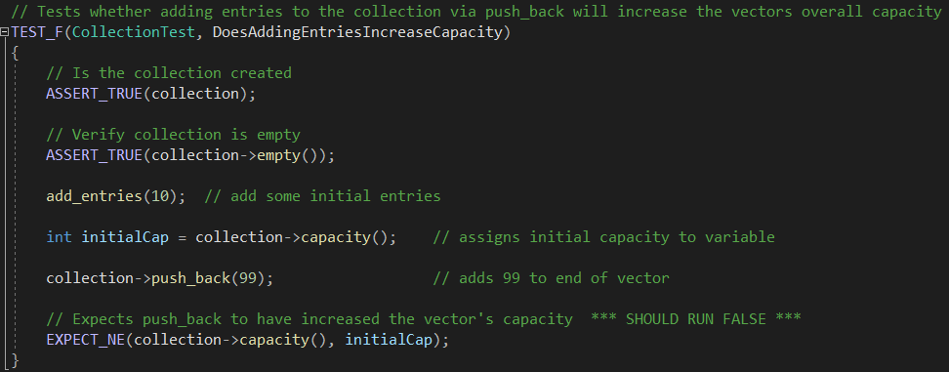
Unit Testing – Capacity #2, intentional Failure
Does Adding Entries to an array increase capacity?
Once again, we test for an intentional failure for a test very similar to our first capacity test.
In this case, adding entries to an array actually does increase its capacity, so expecting the same value as our initial capacity will return a negative test.
This could also be done with a positive test just as easily. Intentional failures should be used according to need.
Result:

Slide 11
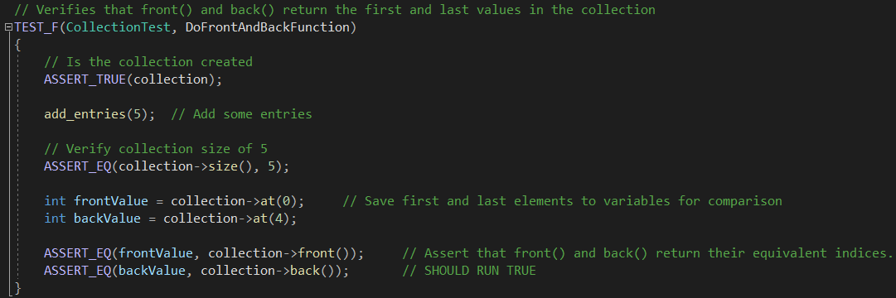
Unit Testing – data type-specific functions
Do data type-specific functions work correctly?
In this unit test, we test the functionality of the array-specific functions front() and back().
Here we create variables within the test that will auto-delete once it is complete.
After adding some entries to our test array, we use front() and back() to return the indices of the first and last elements in the array.
Result:

Slide 12

AUTOMATION SUMMARY

Slide 13
TOOLS
The DevSecOps pipeline is the process through which developers integrate secure coding into the normal software development life cycle workflow. The stages of the pipeline are iterative like an Agile project, and are meant to be carried out as part of, and alongside the main development of a project.
Tools used in DevSecOps:
IDE integrated debugger – The integrated Visual Studio debugger allows for nearly instantaneous fixes and provides suggestions for alternate code.
Static Code Analysis Tool – CppCheck is a standalone code analysis tool that examines static code for potential bugs. Much more thorough than most IDE tools.
Unit testing programs – CppUnit is an example of a standalone Unit-Testing framework that allows unit tests to be run outside of a development environment.
In-IDE Unit Testers - Google Test is an example of a unit package that can be used as part of visual studio to test functionality for individual parts of a program.

Slide 14
RISKS AND BENEFITS
Failing to Fix: If security isn’t prioritized, products are likely to ship with zero-day exploits which may go unnoticed until an attack occurs.
Over-preparing: Conversely, if every possible attack vector is planned for with the utmost care, costs can rise and the project timeline will extend.
Failing to Iterate: Developers should use the DevSecOps pipeline to constantly iterate on their security measures. If security isn’t improved upon, attackers will have an easier time overcoming lax or outdated measures.
Using too few Tools: Some tools are better at detecting certain code flaws than others. If developers rely too heavily on only a few tools, they are likely to overlook some flaws.
Failing to Prioritize: All improvements to a project should be prioritized according to how harmful an attack would be along that vector and how likely an attacker is to use it.

Slide 15
RECOMMENDATIONS
Implement in-person code review: Using in-person or peer reviews will allow developers to better enforce standards that tools might not pick up.
Prioritize code standards: Reorganize the coding standards in order of priority to give developers a working list.
Simplify summaries: Consolidate Severity, Priority, and Level columns of summary and risk assessment to make it more readable.
Make encryption explicit: Establish explicit encryption standards for different levels of data. Different types of encryption offer different levels of security. Explicitly state which types of encryption are needed for which types of data.

Slide 16
CONCLUSIONS
This security policy puts Green Pace in a good position to preemptively handle security problems while developing software.
That being said, this policy is still rudimentary and should be iterated upon at least annually.
Even a well-positioned security framework is inadequate if developers don’t stay informed about emerging threats.
The company’s current informational assets and threat landscape will likely change over time. The priorities of different coding standards can be reevaluated as the business grows.
Expanding and editing this policy should be implemented as part of the DevSecOps pipeline, and developers should be encouraged to submit feedback regarding possible amendments and alterations to future versions of the policy.

